Slide 1
Funding new projects with tolls

Slide 2
Uses of Tolling
Revenue generation to support
  Construction
  Operations
  Maintenance
Traffic management
  Optimization of available capacity
  Management of peak period trips

Slide 3
Generation of Capital
Financing mechanisms
  Debt backed by taxes
    GARVEE Bonds, general obligation bonds
  Debt backed by toll revenue
    Revenue bonds, TIFIA loans/credit assistance
  Equity contributions
    State funds, grants
    Public-private partnerships

Slide 4
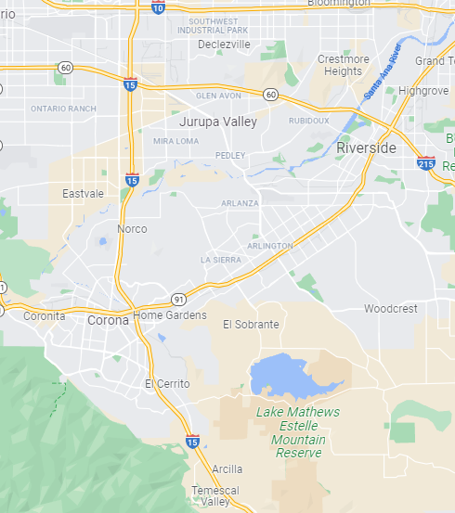
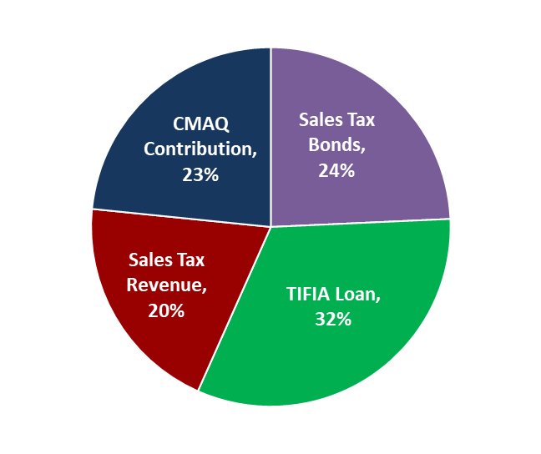
I-15 Express Lanes
Riverside County, California
14.6 miles
Tolled managed lanes along I-15 corridor
Funded using both toll revenue (pledged to repay TIFIA loan) and sales tax revenue

Slide 5
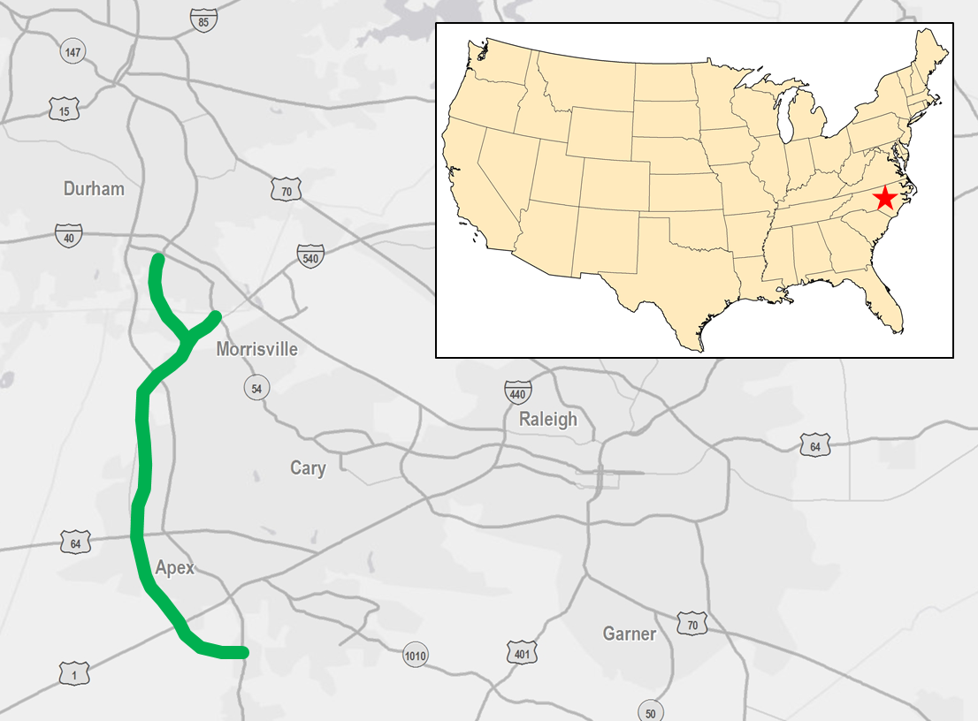
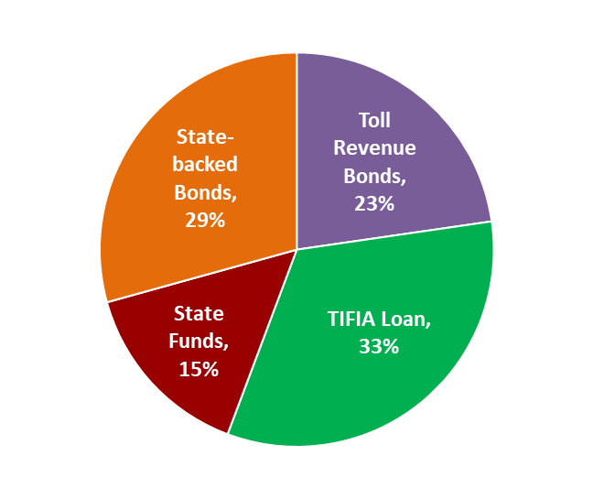
Triangle Expressway
Raleigh-Durham, North Carolina
18.8-miles
Multiple financing methods
  Toll revenue bonds, TIFIA loan, bonds backed by state tax revenue, additional state funds
  55.7% of total financing backed by toll revenue

Slide 6
Tolling Objectives/Tolling Approaches
Payment options
  Transponder
  Video (license plate)
Toll rate conditions
  Toll rates
    Flat (same all day)
    Fixed schedule variable pricing
    Dynamic pricing
  Discounts
    Residency based
    Occupancy based
    Classification based

Slide 7
Toll Facility Development Overview
Can we generate enough money to make tolling worthwhile?
  Feasibility Assessment
How do we know how much money we can generate from tolling?
  Traffic and Revenue Projection Process
If we can generate enough money, how do we finance it?
  Project Financing

Slide 8
Elements of a Feasibility Study

Slide 9
Traffic and Revenue: Key Questions
What is the overall travel demand in the corridor?
How much will it grow in the future?
What share of the demand can be expected to use the new facility?
How much will users be willing to pay?
Types of studies
Sketch
Preliminary
Comprehensive or
Investment Grade

Slide 10
Typical T&R Process Flowchart
Inputs
Traffic Data
Key Assumptions
Configuration
Discounts
Payment methods
Processes/ Calculations
Outputs
Speed Data
Travel Demand Model
Revenue Calculation
Travel Pattern Data
Willingness
To Pay
Demographic Forecasts
Revenue Estimates
Traffic Forecasts

Slide 11
Project Cost Evaluation
Construction costs
Maintenance costs
Operations costs
Examples

Slide 12
Project Risks
Category | Types
Environmental | EIS / ROD Mitigation
Litigation | Threatened and Filed
Force Majeure | Fire, Flood, Earthquakes, Terrorism, Wars
Economic | Forecasts, Gas Prices, Financing Risks, Inflation, World Economy
Political/Institutional | Taxes, Legal Structures, Public Sentiment
Performance | Costs, Design, Contractors, Partnership Funding
Operating | Equipment, Structural Failures, Competing Routes, Toll Collection

Slide 13
Risk Management
Toll project financing risk
  Toll revenue realization
  Competing improvements
  Risk assumed by developer of roadway
Potential mitigation
  Existing corridors with known traffic patterns tend to be perceived as slightly lower risk profile than greenfield/new corridors
  Private concessions

Slide 14
Summary
Tolling has proven to be an effective funding source for new highway capacity as state and federal tax revenues diminish
  In many cases, tolling cannot support the entire cost of projects
  Must be supplemented with other funding sources
Risks/considerations
  Demographic/traffic growth
  Financial coverage
  Public opinion
  Institutional structures

