Slide 1
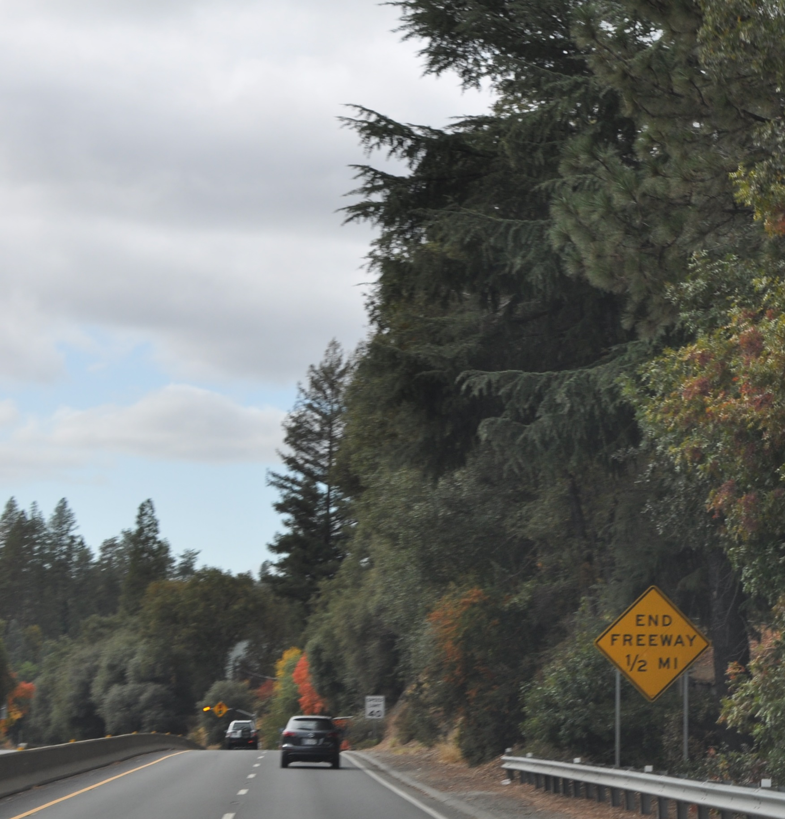



El Dorado County Transportation Commission
June 2, 2022

Slide 2

Agenda
Study Purpose and Recap
US 50 Trip to Green
US 50 Corridor System User Traveler Analysis
Financing Investment Strategy Overview
Next Steps

Slide 3
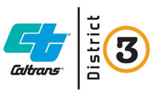



PDT Role and Make-Up
Project Development Team Roles and Expectations
Collaborate on study processes, findings and recommendations
Provide technical input and expertise
Coordinate needs, responsibilities and actions within respective organizations
Ensure we develop the most effective plan possible for the traveling public

Slide 4
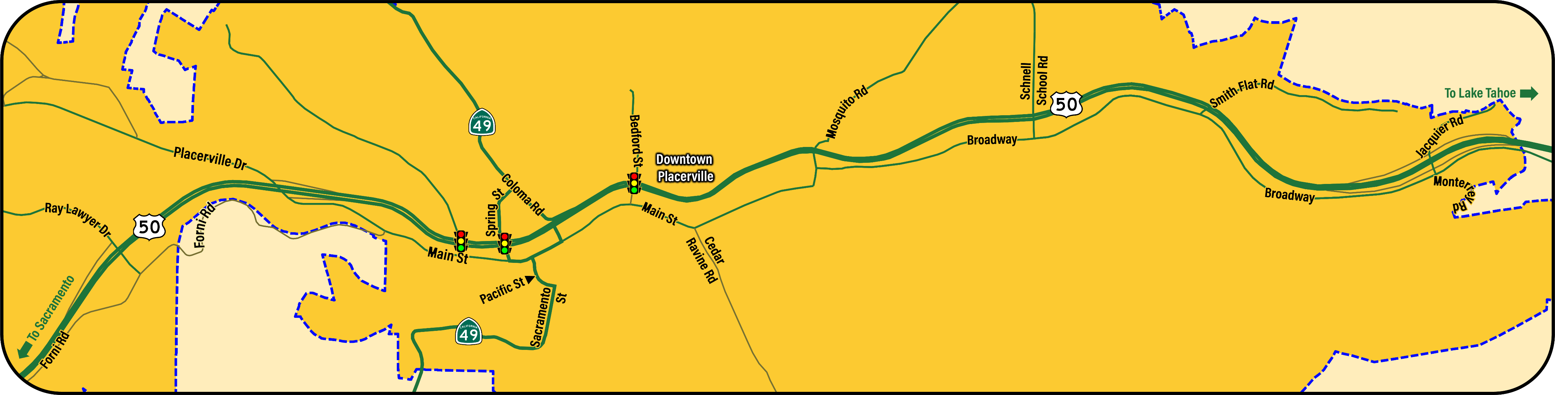

Study Area

Slide 5
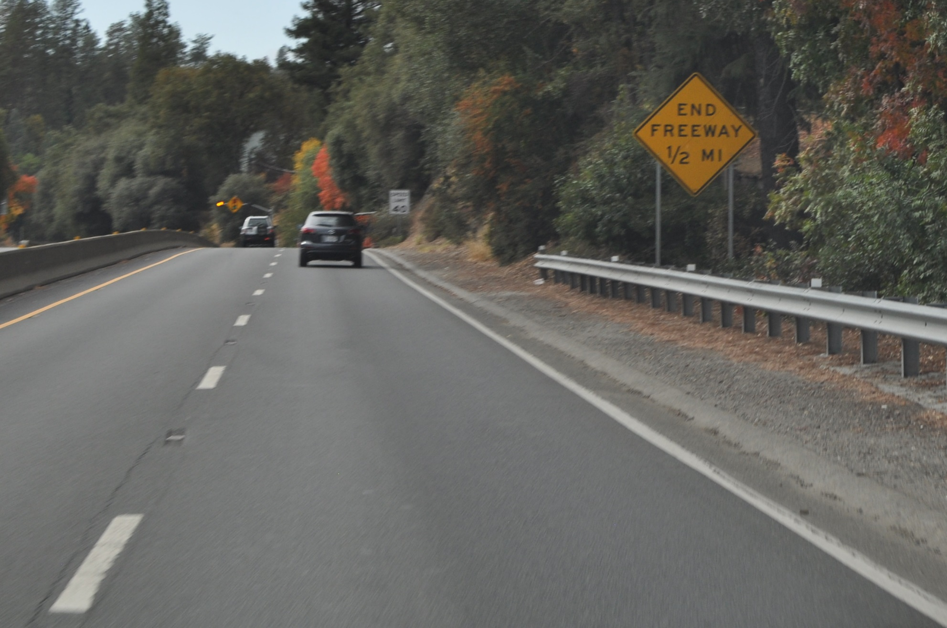
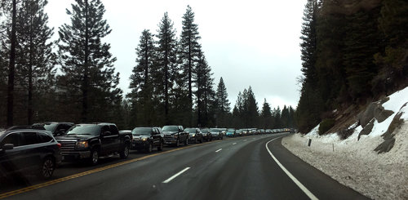
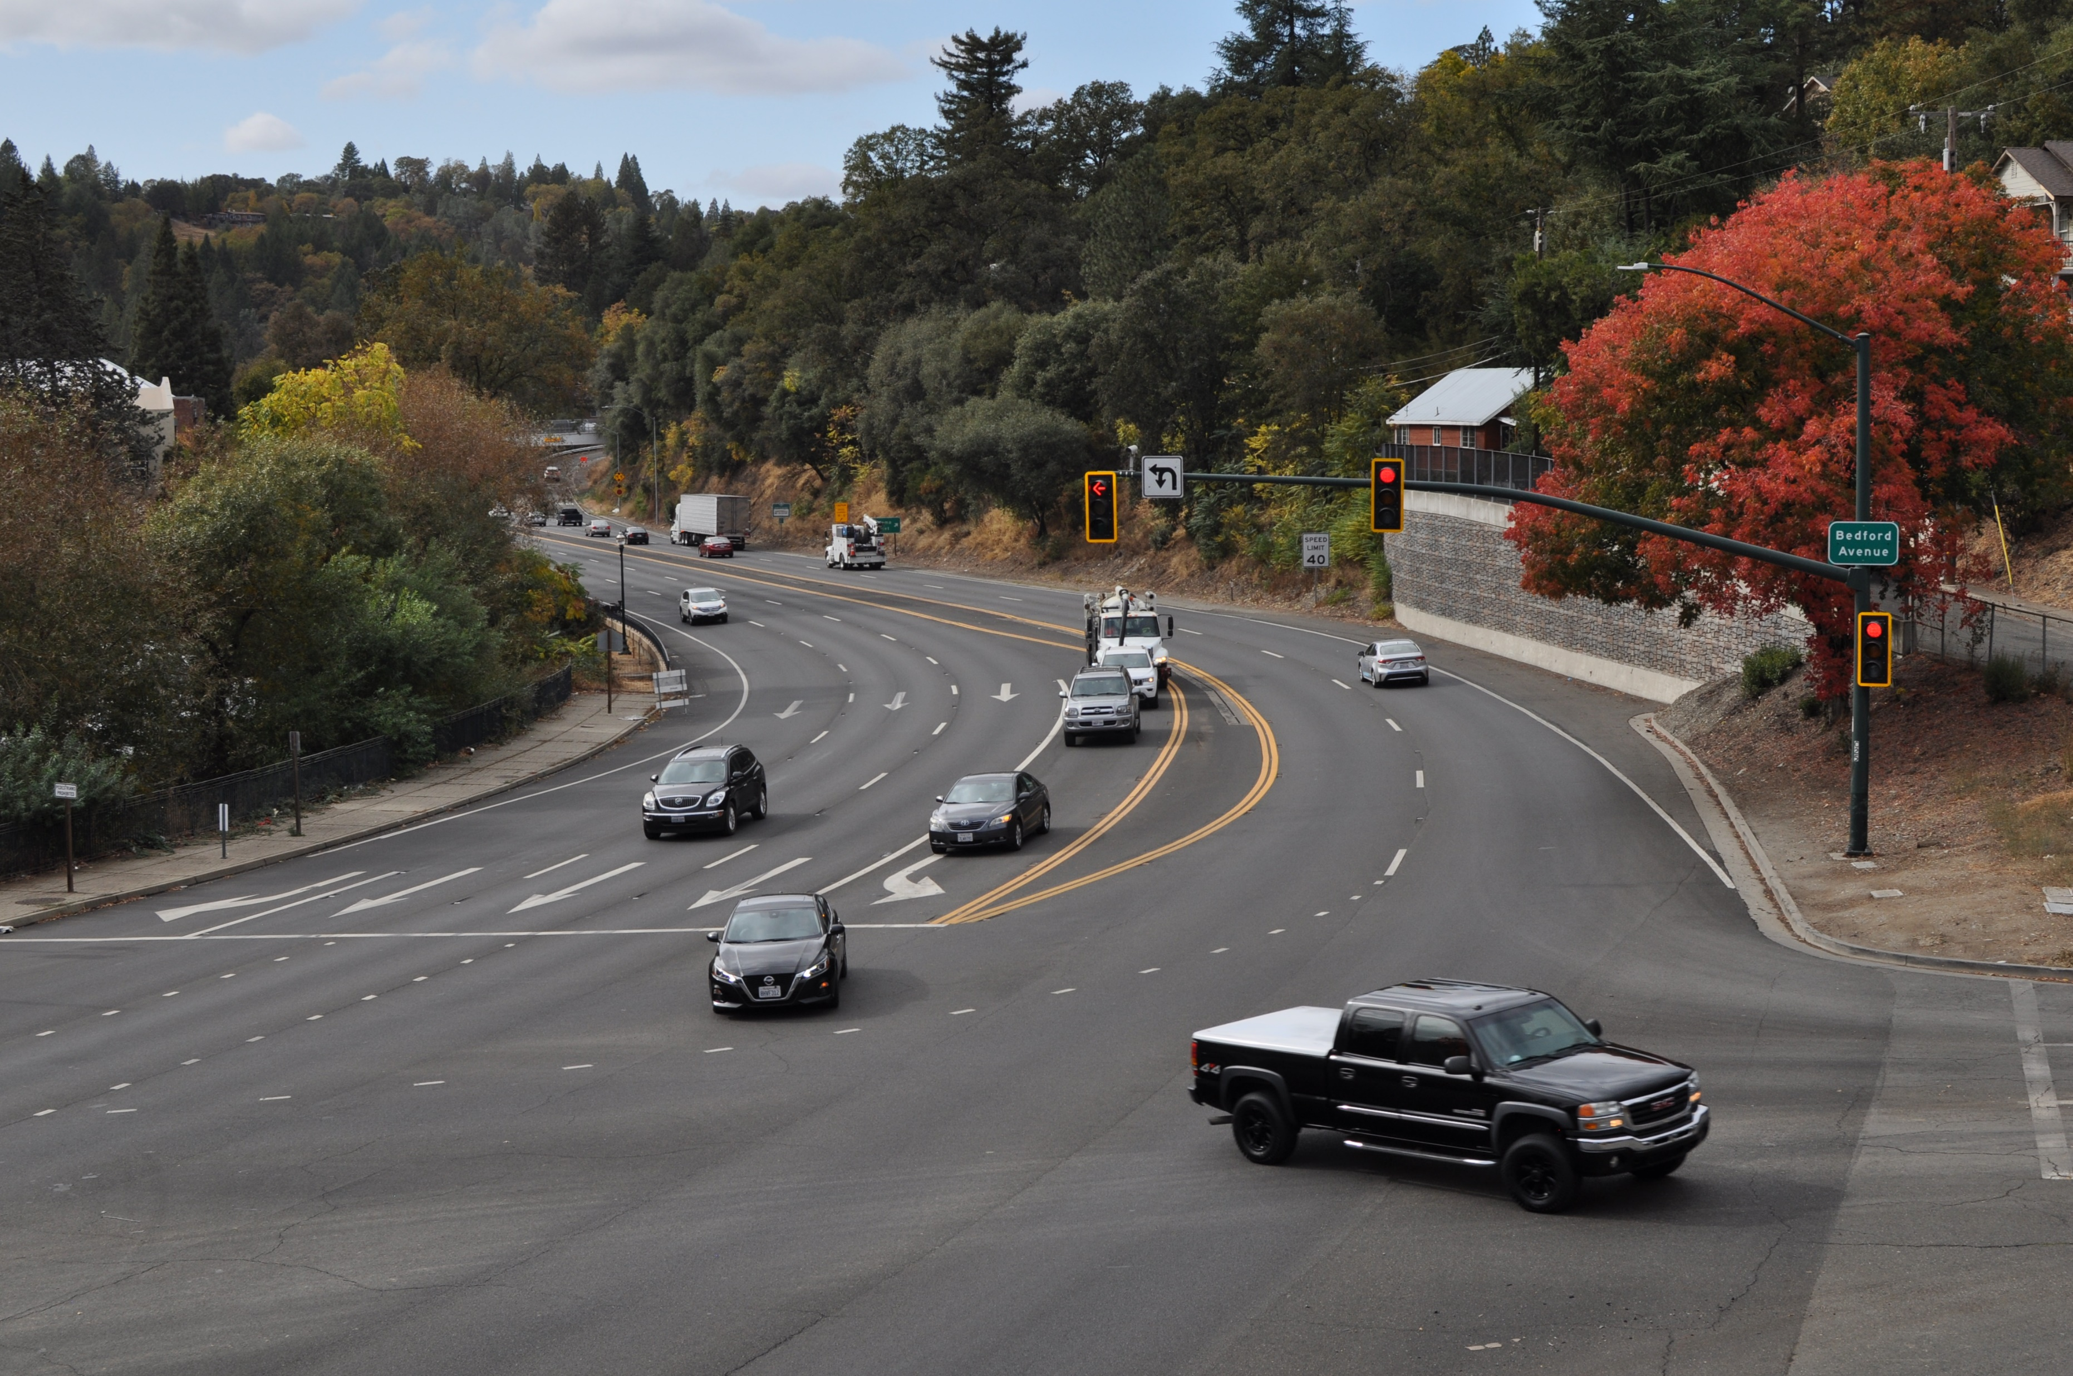
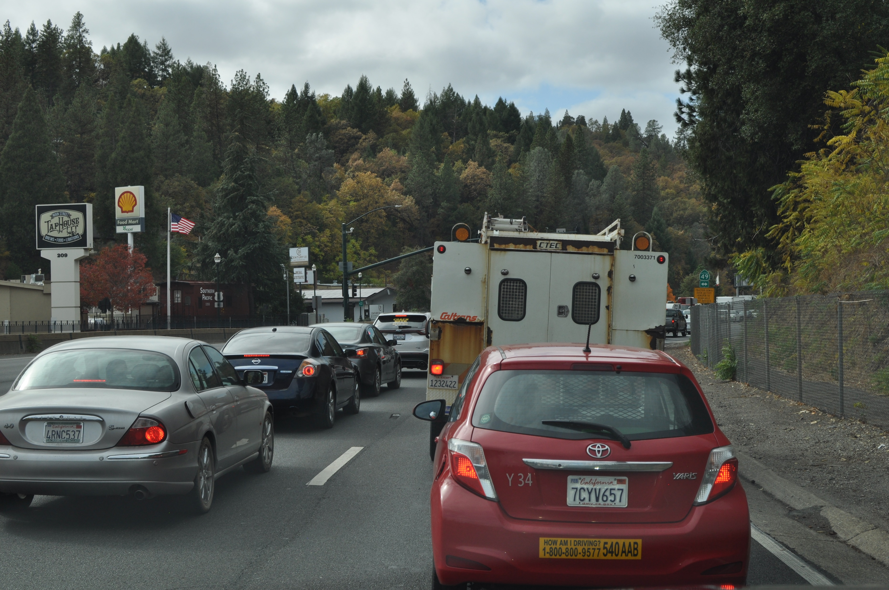
Study Purpose
Signalized Intersections
Result in Congestion

Slide 6
Study Purpose
Project Study Report
Considered grade-separations, flyover ramps, and widening
1996
Placerville Traffic Operational Improvements Traffic Report
Analyzed improvements that were determined to not eliminate congestion
2000
Hwy 50 Operational Improvements Constructed
Eastbound aux lane, Hangtown bridge, and Placerville Dr. connection
Project Report 2002
2008
Bay to Tahoe Basin Tourism and Recreational Travel Impact Study and Agritourism Study Looked at travel characteristics through the study area
2014 / 2016
US50 Hot Spot Study
Identified, evaluated, and recommended traffic management strategies
2020

Slide 7
Schedule Overview and Key Tasks
Q4 22 |
| Q1 21
Access Control Plan for US 50 in Placerville
System User Analysis
Financing Strategies
Final Plan
Public Outreach

Slide 8
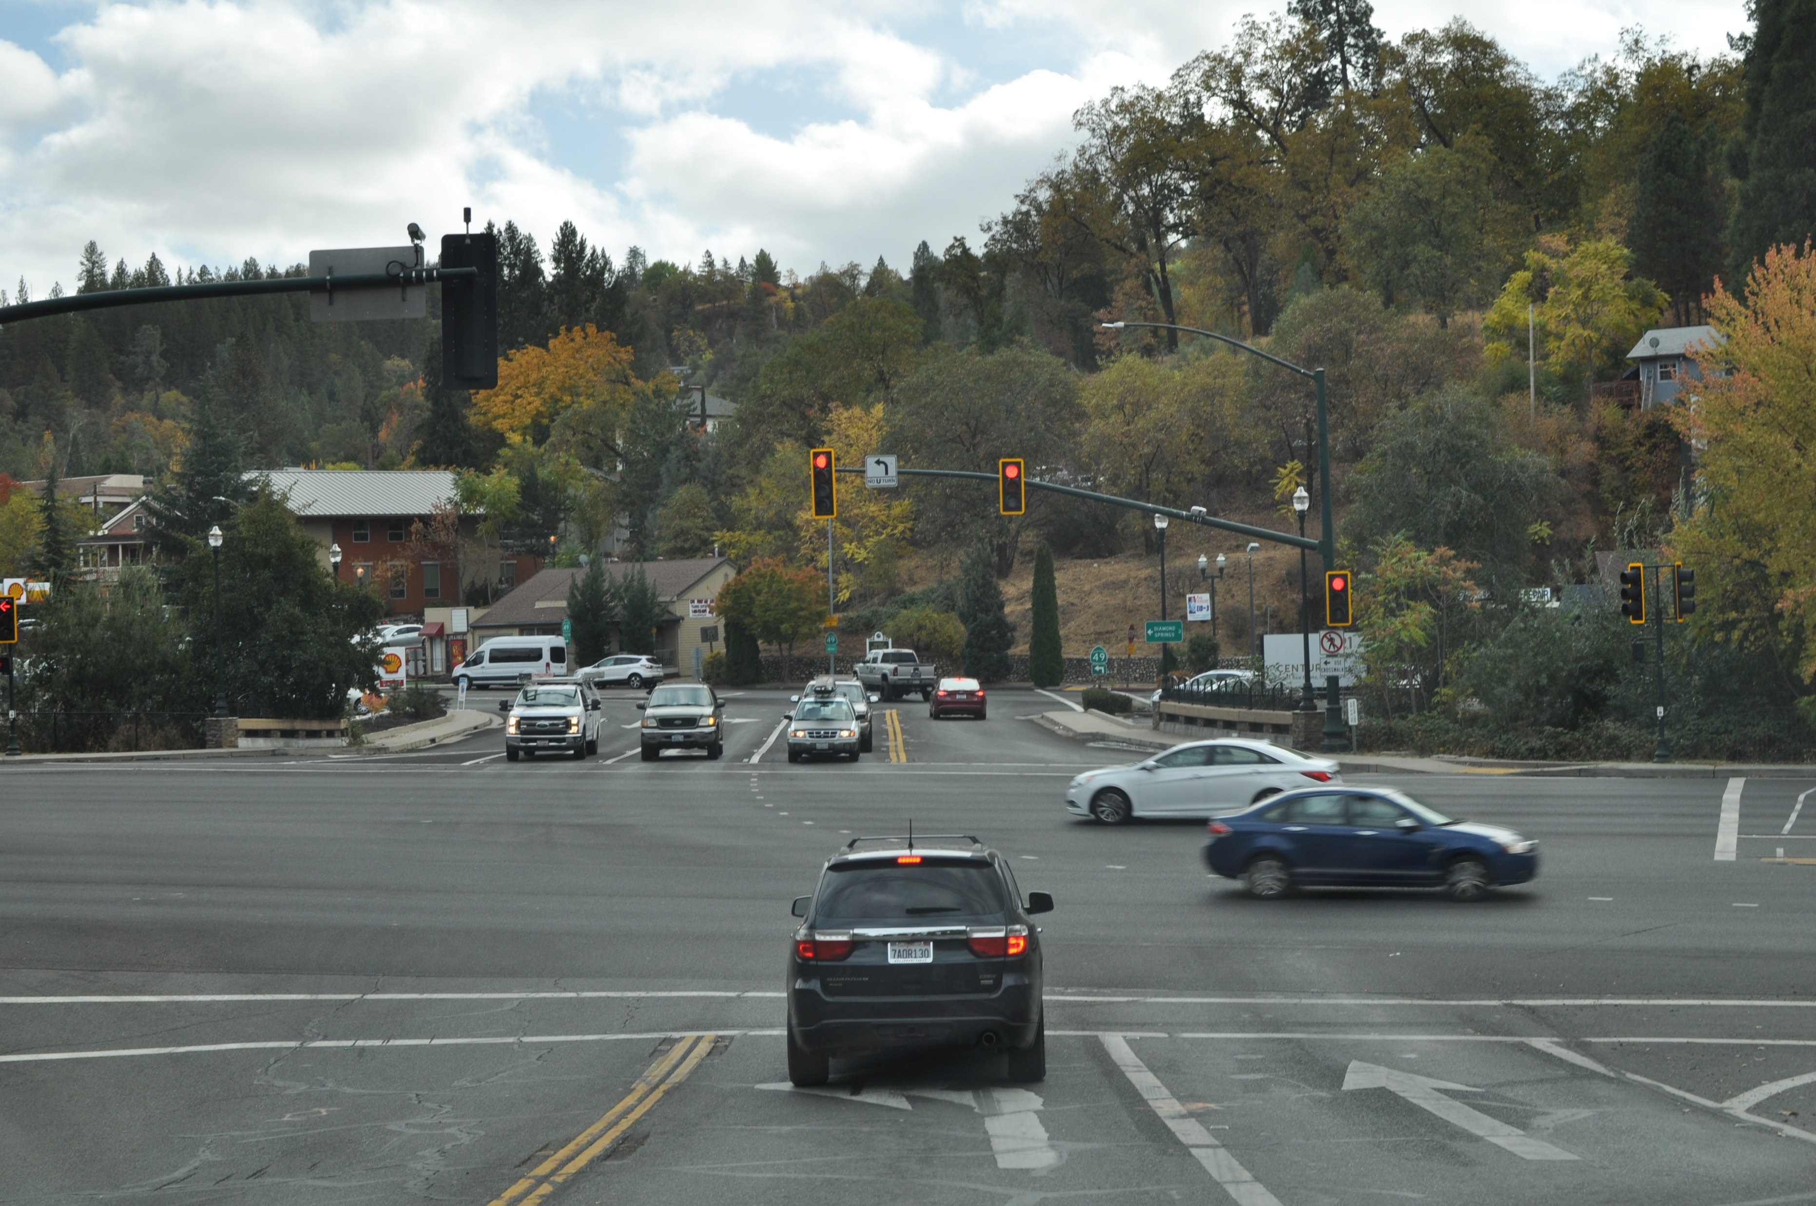
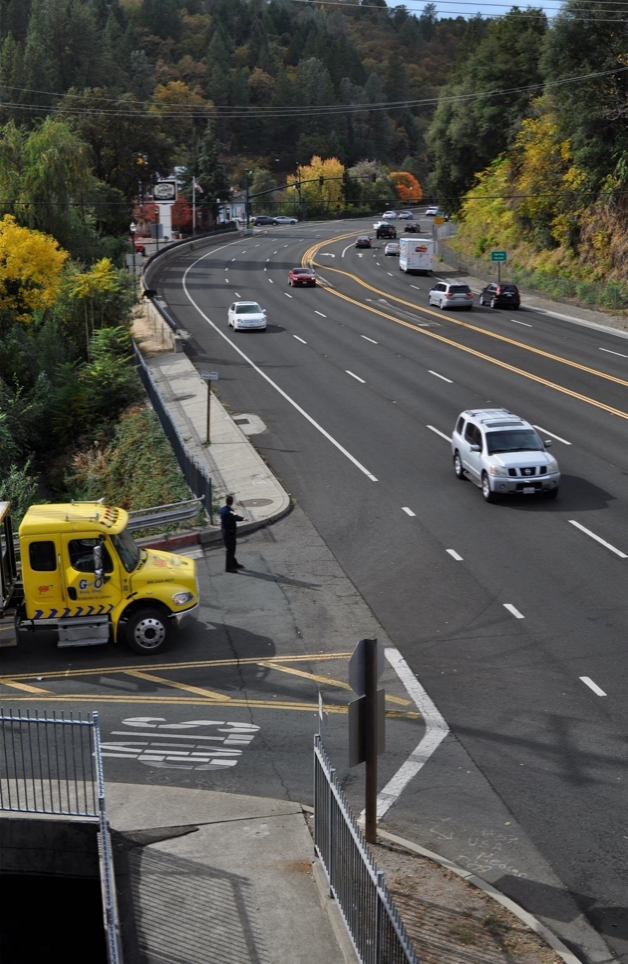
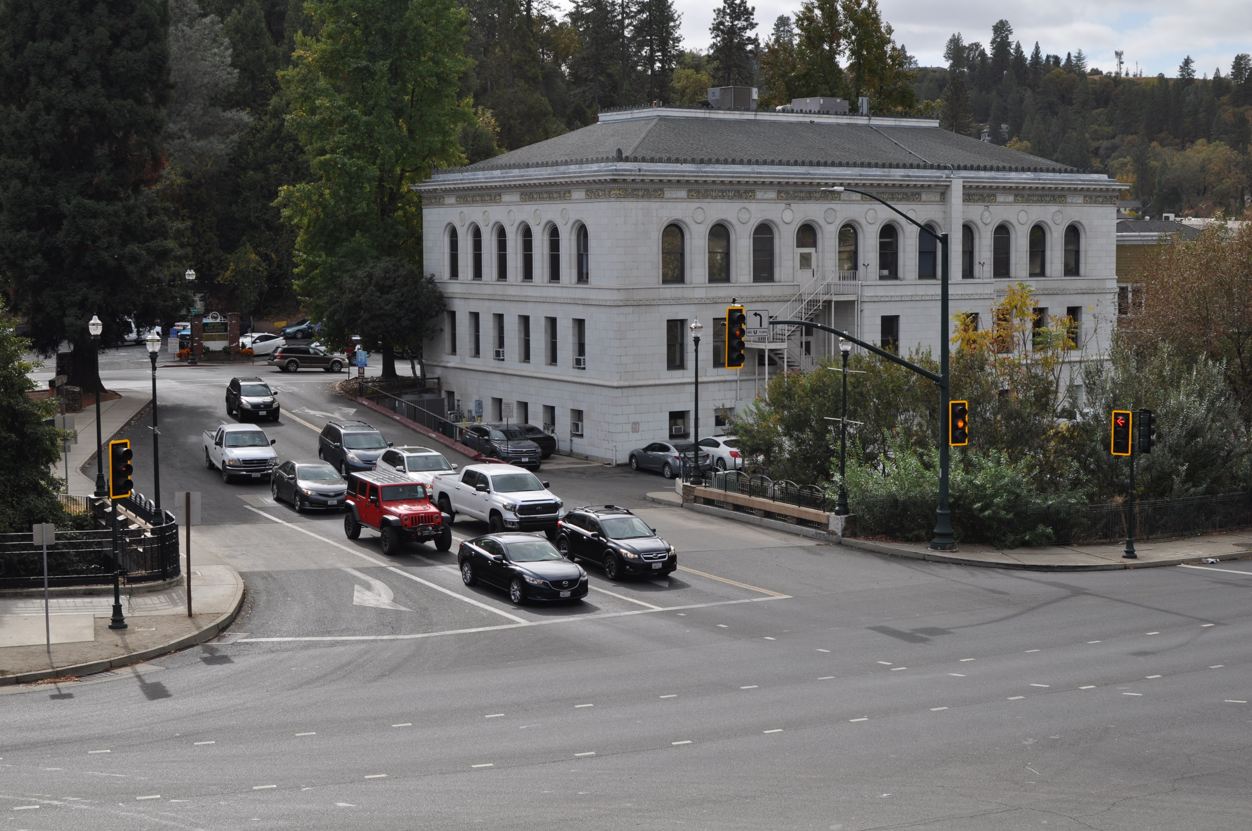
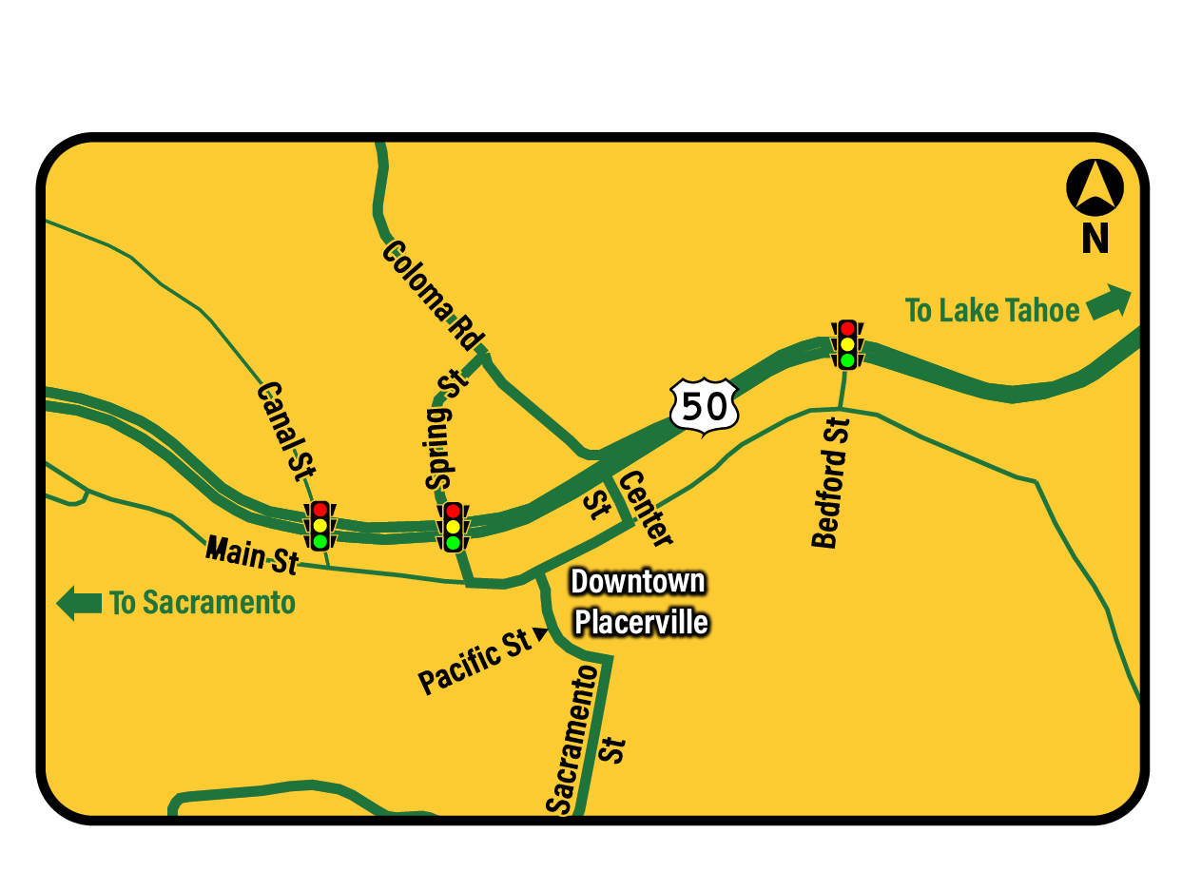
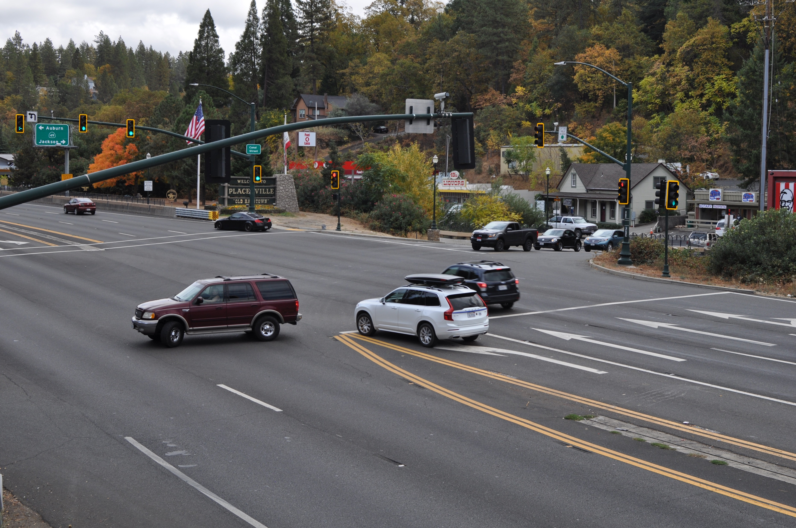
Trip to Green
Spring St.
Center St.
Bedford St.
Canal St.
Access Control Plan Proof of Concept

Slide 9



Action Plan Concept Overview
Continuous Green for US 50 Thru Traffic at all 3 Signals in Downtown Placerville
Prohibit Local Movements Across US 50 and Limit Local Access
Reroute Local Access and North/South Movements Across US 50

Slide 10

Trip to Green
2021 Trip to Green Development:
Planned Trip to Green Implementation:
  Sept. 24-26, 2021: Friday 12am-Sunday 10pm
  Oct. 15-17, 2021: Friday 12am-Sunday 10pm
Caldor Fire: August 14 – October 21
Cancelled Trip to Green Deployment
2022 Trip to Green Deployment:
Up to 3 Deployments Planned:
  August 6-7, 2022: Saturday 7am-Sunday 7pm
  September 3-5, 2022: Saturday 7am-Monday 7pm
  October 1-2, 2022: Saturday 7am-Sunday 7pm

Slide 11
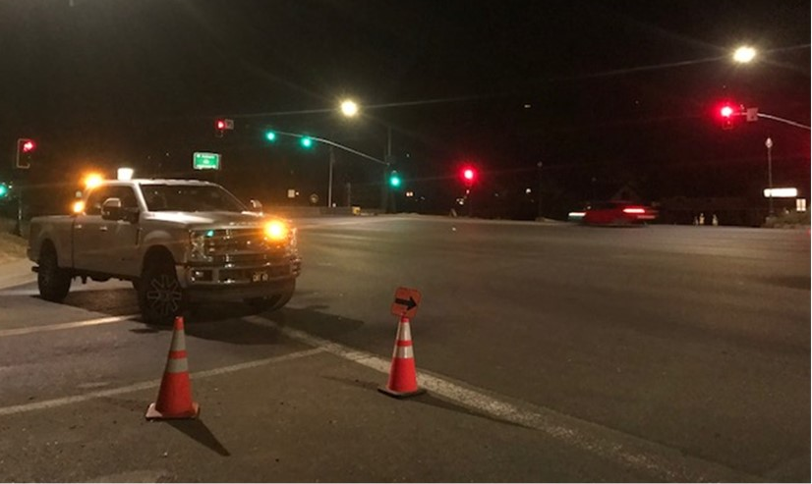
Lessons Learned from Caldor Fire
Continuous Green and Detours Implemented:
Set-up takes about 2 hours, can consider daylight hour only versus 24-hours/day during weekends
Revealed specific locations to intercept detoured traffic
Ensure plenty of signage for no lefts off US 50
Close left turns from US 50 first, then close the side streets
Each intersection does need to be staffed. Experienced a lot of public interactions.
Bike and pedestrian activity higher than expected
Identified additional CMS locations
Caldor Fire Closure

Slide 12
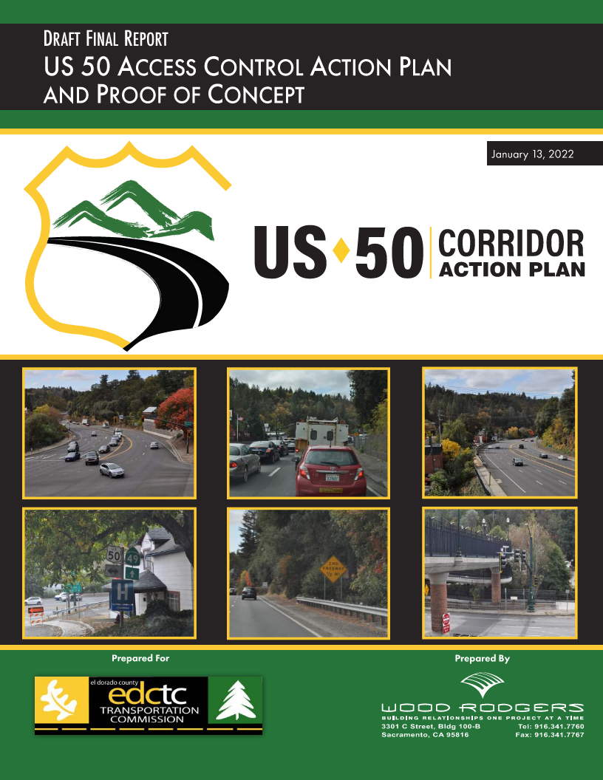
Final Report
US 50 Access Control Action Plan and Proof of Concept Draft Report
Documents the development of the Access Control Plan and Proof of Concept
Includes risk matrix, proof of concept plan sheets, and documents coordination
Also includes lessons learned from Caldor Fire

Slide 13

Trip to Green Grant Application
INFRA/Rural Grant Application
Grant application submitted for long term trip to green infrastructure and PSR for future ultimate improvements
Total grant request of $12,240,000 (RURAL)
            $10,050,000 (INFRA)
            $16,750,000 (Total Project Cost)
Submitted May 23, 2022
Competitive grant process
Future rounds of grant funding through this program are anticipated

Slide 14
System User Travel Analysis

Slide 15
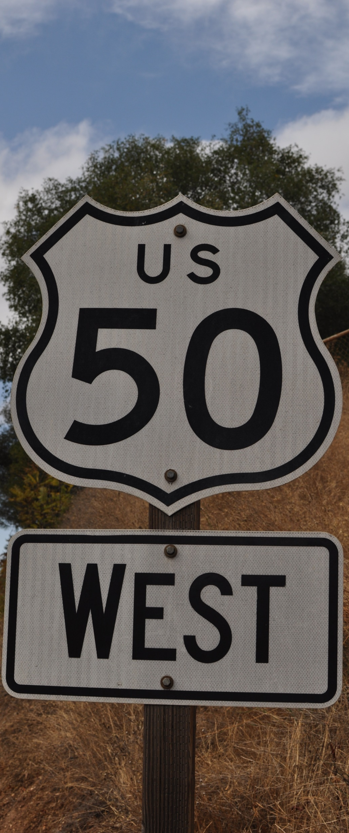
System User Travel Analysis
Purpose and Methods:
Purpose: Develop an understanding of US 50 travel patterns including origin/destination, travel characteristics, and traveler information
Method: Applied the Replica platform leveraging SACOG’s license agreement to mine data obtained from location-based devices
Replicahq.com

Slide 16
Average Daily Traffic
PeMS data, Oct. 2019
Average Daily Traffic
US 50 West of Placerville Drive
Saturday
US 50 ADT
Total: 49,600
EB: 25,700
WB: 23,900
Weekday
Sunday
US 50 ADT
Total: 45,200
EB: 22,300
WB: 22,900
US 50 ADT
Total: 45,300
EB: 20,500
WB: 24,800

Slide 17
Residents vs Visitors
Replica data, Sept.-Nov. 2019. Weekday as average Thursday
US 50 at Bedford Avenue
Weekday
Saturday

Slide 18
Trip Distance
US 50 at Bedford Avenue
Average Distance = 96 mi
Average Distance = 104 mi
Placerville
Shingle
Springs
El Dorado
Hills
Folsom
Placerville
Shingle
Springs
El Dorado
Hills
Folsom
Sacramento
Bay Area
Weekday
Saturday

Slide 19
Trip Distance Takeaways
Summary Data:
76%
Percent of vehicles on US 50 in Placerville on Saturdays that are traveling at least 32 miles.
  This equates to approximately 38,000 long-distance vehicle trips; or 63,000 long-distance person trips.
6x
The 63,000 persons making long distance trips on US 50 during one Saturday is equal to nearly 6 times the population of Placerville.

Slide 20
Trip Origins
Eastbound US 50 at Bedford Avenue
Weekday
Saturday

Slide 21
Trip Destinations
Eastbound US 50 at Bedford Avenue (Fall)
Weekday
Saturday

Slide 22
Trip Purpose
US 50 at Bedford Avenue
Weekday
Saturday

Slide 23
Trip Mode
Eastbound US 50 at Bedford Avenue
Private Auto Occupancy = 1.67 persons per vehicle
Private Auto Occupancy = 1.90 persons per vehicle
Weekday
Saturday

Slide 24
Household Income
US 50 at Bedford Avenue
Weekday
Saturday

Slide 25
Financing and Investment Strategy

Slide 26
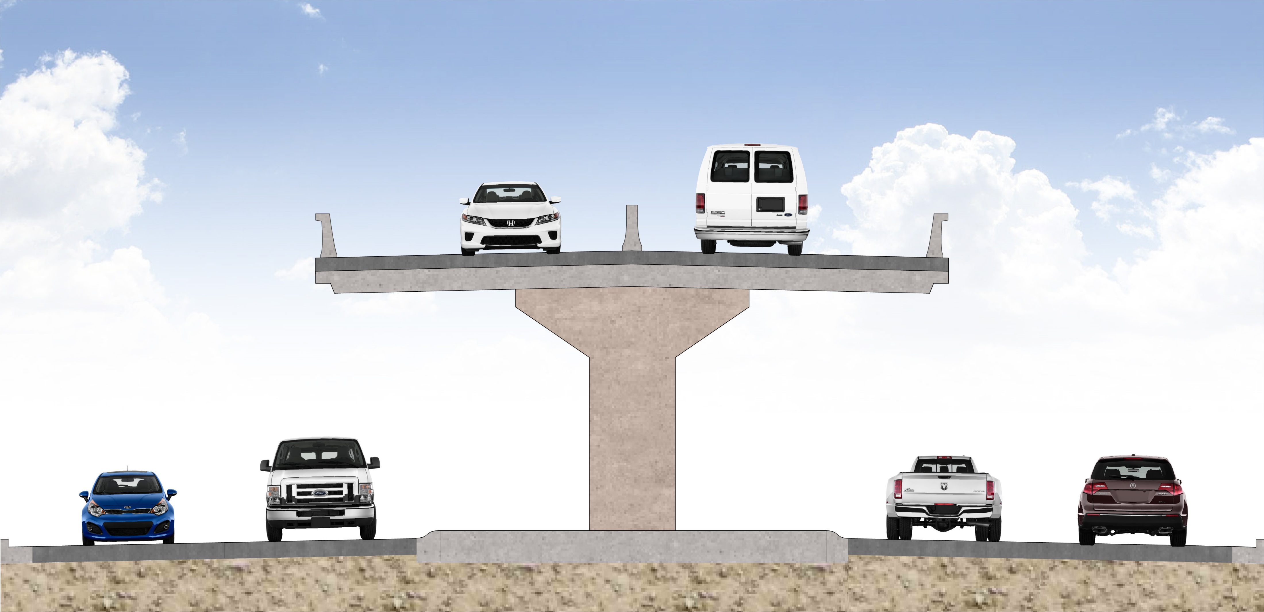
Financing and Investment Strategy
Purpose and Methods:
Purpose: Develop a detailed description of financing and investment strategies for potential permanent solutions
Method: Conduct a sketch-level toll feasibility analysis for a potential permanent concept, as well as considerations for tolling a Trip to Green condition

Slide 27



Toll Facility Development Overview
How do we know how much money we can generate from tolling?
  Traffic and Revenue Projection Process
Can we generate enough money to make tolling worthwhile?
  Feasibility Assessment
If we can generate enough money, how do we finance it?
  Project Financing

Slide 28
Traffic and Revenue Studies
Types of Studies
Sketch level
Preliminary
Investment Grade
Key Elements
Data collection
Economic review
Travel demand model
Project assumptions
We Are Here

Slide 29
Elements of a Feasibility Study

Slide 30

Traffic and Revenue: Key Questions
What is the overall travel demand in the corridor?
How much will it grow in the future?
What share of the demand can be expected to use the new facility?
How much will users be willing to pay?

Slide 31

In Summary
Tolling has proven to be an effective funding source for new highway capacity as state and federal tax revenues diminish
  In many cases, however, tolling cannot support the entire cost of projects
  Must be supplemented with alternative funding sources
Preliminary results suggest tolling would provide only limited funding
  Express lanes yield ~$1.5 million/yr ($0.50-$1.75 rate)
  Trip to Green yields ~$850k-$2.2 million/yr ($1-$3 rate)
Need to further advance feasibility results to inform next steps

Slide 32
Next Steps
Q4 22 |
| Q1 21
Access Control Plan for US 50 in Placerville
System User Analysis
Financing Strategies
Final Plan
Public Outreach

Slide 33

EDCTC Contact
Jerry Barton
Senior Transportation Planner
EDCTC
jbarton@edctc.org
530-642-5267

